Slide 1
Design and Analysis of Algorithms
Algorithms-II : CS345A
Lecture 1
Overview of the course
Motivational Problems

Slide 2
Aim of the course
To empower each student with the skills to design algorithms
With provable guarantee on correctness.
With provable guarantee on efficiency.
Course website:
moodle.cse.iitk.ac.in
Login as guest

Slide 3
Problem 1
The Stable Marriage Problem
This algorithmic problem lies at the core of the “Joint Seat Allocation” software.
This software assigned you to your discipline at IIT Kanpur in 2020/21.

Slide 4
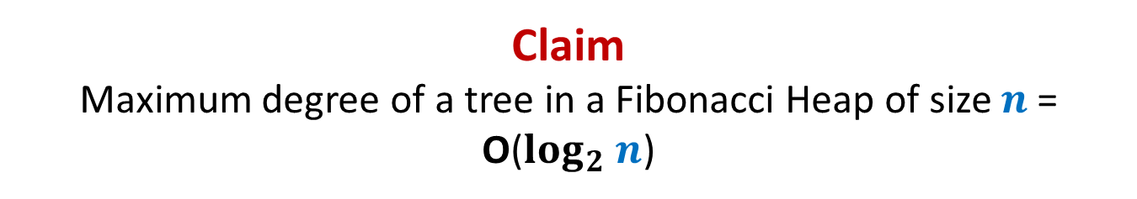












Stable Marriage Problem
Women
Men
$$w_{1}$$
$$m_{1}$$
$$3$$
…
$$w_{2}$$
$$m_{2}$$
$$1$$
…..
$$w_{3}$$
$$m_{3}$$
$$2$$
$$w_{i}$$
$$m_{j}$$
$$w_{n}$$
$$m_{n}$$

Slide 5




Stable Marriage Problem
Women
Men
$$w_{1}$$
$$m_{1}$$
$$3$$
$$w_{2}$$
$$m_{2}$$
…
…
$$1$$
$$w_{3}$$
$$m_{3}$$
…..
$$2$$
$$k$$
$$w_{i}$$
$$m_{j}$$
$$w_{n}$$
$$m_{n}$$

Slide 6
Stable Marriage Problem
Women
Men
Marriage : ?
$$w_{1}$$
$$m_{1}$$
$$w_{2}$$
$$m_{2}$$
$$w_{3}$$
$$m_{3}$$
…
…
$$w_{i}$$
$$m_{j}$$
…
…
$$w_{n}$$
$$m_{n}$$
a bijection between Women and Men

Slide 7




Stable Marriage Problem
Meaning of unstability
$w_{l}$ prefers $m_{j}$ to $m_{k}$
$m_{j}$ prefers $w_{l}$ to $w_{i}$
Definition:
A marriage is said to be stable if there is no unstable pair in the society.
($w_{l}$, $m_{j}$) : an unstable pair
$$w_{l}$$
divorce
$$m_{k}$$
$$w_{i}$$
divorce
$$m_{j}$$

Slide 8

Stable Marriage Problem
$M$ : set of $n$men
$W$ : set of $n$women
For each man $m∈M$,
$L(m)$: a preference list of all women
For each woman $w∈W$,
$L(w)$: a preference list of all men
Aim: To compute a stable marriage.

Slide 9
Problem 2
The Unique-path Problem

Slide 10




Unique-path graph
Definition: A directed graph $G$=($V$, $E$) is said to be unique-path graph if
For each pair $u$, $v∈V$, there is at most one path from $u$ to $v$.
In other words,
$u⇝v$
Aim: Design an efficient algorithm to determine if $G$ is unique-path graph.
➔ there is only one path from $u$ to $v$
An O($n^{2})$ time algorithm
y
u
v
q
b
d
w
j
r
p
h
c
t
k

Slide 11
Problem 3
The Huffman Coding Problem

Slide 12
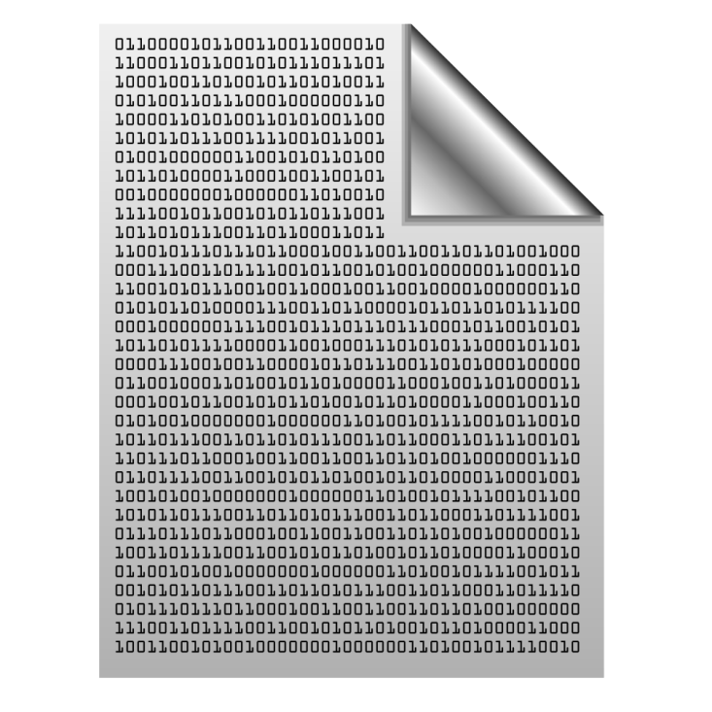
Binary coding
alphabet set $A$: {$a_{1}$, $a_{2}$,…, $a_{n}$ }
A text File: a sequence of alphabets
Question: How many bits needed to encode a text file of size $m$ alphabets ?
Answer: $m \left\lceil \log_{2} n\right\rceil$ bits.
once upon a time …………..
…………………………….
……………………………..
…………………
A text file F
Binary coding of F

Slide 13
Fixed length coding
alphabet set $A$: {$a_{1}$, $a_{2}$,…, $a_{n}$ }
Question: What is a binary coding of $A$?
Answer: $γ$: $A$→binary strings
Question: What is a fixed length coding of $A$?
Answer: each alphabet ← a unique binary string of length $\left\lceil \log_{2} n\right\rceil$.
Question: How to decode a fixed length binary coding?
Answer: easy ☺
$$0100101000001011…$$

Slide 14
Fixed length coding
alphabet set $A$: {$a_{1}$, $a_{2}$,…, $a_{n}$ }
Question: Can we use fewer than $\left\lceil \log_{2} n\right\rceil$ bits for each alphabet of $A$ ?
Answer: No.
Question: Can we use fewer than $m \left\lceil \log_{2} n\right\rceil$ bits to store a file of length $m$?
Answer: Yes most likely.

Slide 15
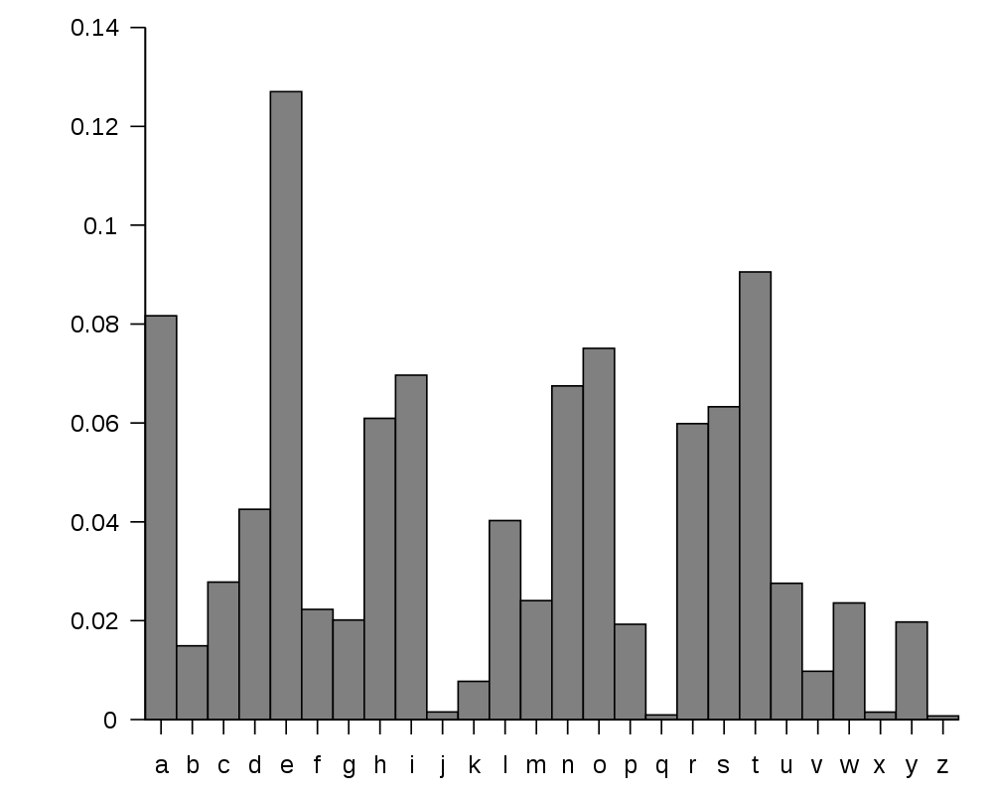
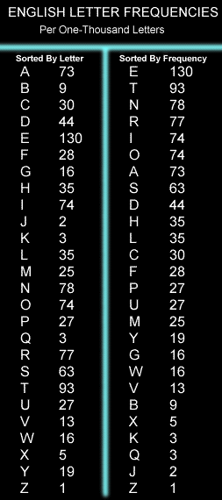
huge variation in the frequency of alphabets in a text.
http://en.wikipedia.org/wiki/Letter_frequency

Slide 16
huge variation in the frequency of alphabets in a text.
Question: How to exploit variation in the frequencies of alphabets ?
Answer:
More frequent alphabets ⬅ coding with shorter bit string
Less frequent alphabets ⬅ coding with longer bit string

Slide 17
Problem 4
A Physics Problem

Slide 18



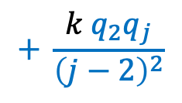




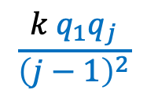
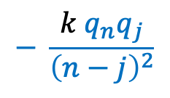

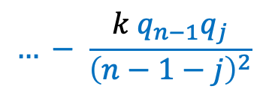
$$1$$
$$1$$
$$1$$
$⊕$ $⊕ ⊕…$ $⊕$ … $⊕$ $⊕$
$$q_{1} q_{2} q_{3} q_{j} q_{n−1} q_{n}$$
$F_{j}$ : Force exerted on $q_{j}$
Aim: Compute $F_{j}$ for each $1≤j≤n$
$$\frac{k{ q}_{1}q_{j}}{{\left(j−1\right)}^{2}}$$
$$+ \frac{k{ q}_{2}q_{j}}{{\left(j−2\right)}^{2}}$$
$$…+ \frac{k{ q}_{j−1}q_{j}}{{\left(1\right)}^{2}}$$
$$F_{j}=$$
$O(n)$time
$$− \frac{k{ q}_{j+1}q_{j}}{{\left(1\right)}^{2}}$$
$$… − \frac{k{ q}_{n−1}q_{j}}{{\left(n−1−j\right)}^{2}}$$
$$− \frac{k{ q}_{n}q_{j}}{{\left(n−j\right)}^{2}}$$
in $O(n log n)$time.

Slide 19
Problem 5
Closest Pair Distance

Slide 20





Distance between 2 points
$$(x_{j},y_{j})$$
O($1$) time
$$(x_{i},y_{i})$$
$$y$$
$$x$$

Slide 21

The Closest Pair Distance Problem
$$δ$$
$$y$$
$$x$$

Slide 22
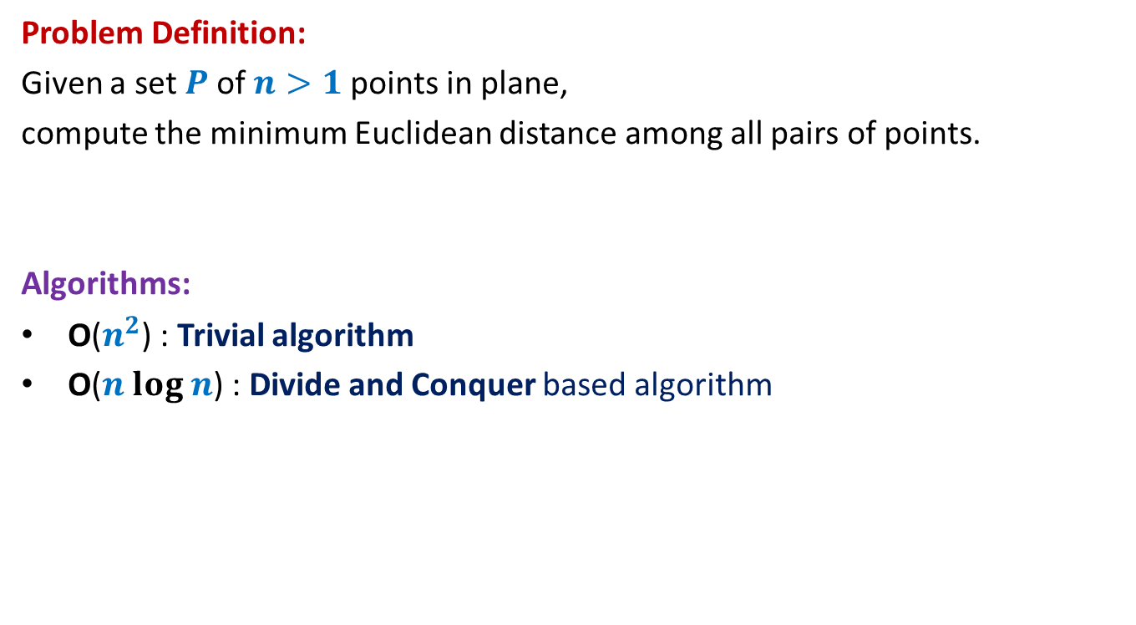
The Closest Pair Distance Problem
Problem Definition:
Given a set $P$of $n>1$points in plane,
compute the minimum Euclidean distance among all pairs of points.
Algorithms:
O($n^{2}$) : Trivial algorithm
O($n log n$) : Divide and Conquer based algorithm

Slide 23

Question 1
Tool 1
A fact from high school geometry
Fact :
Let $p=(x_{1},y_{1})$ and $q=(x_{2},y_{2})$ be any two points.
If $\left|x_{1}−x_{2}\right|>δ$, distance($p,q$) $>δ$
If $\left|y_{1}−y_{2}\right|>δ$, distance($p,q$) $>δ$

Slide 24
Question 2
Tool 2
A fundamental question about data structure ?
Question:
While solving an algorithmic problem, when do we feel the need of an
efficient data structure ?
Answer:
when the algorithm involves “many” operations of same type on a given data.
Notes:
For example, it is worth sorting an array only if there are going to be many search queries on it.
Let us see if you can use this principle to solve this problem.

Slide 25
a Divide and Conquer algorithm for
Closest Pair Distance

Slide 26


The divide step
$$y$$
$$x$$

Slide 27
Homework
Ponder over the algorithm.
How will you divide the problem ?
How will you make use of the two tools to solve the problem ?
Spend at least 30 minutes pondering over these questions
before coming to the next class.

